Slide 1
Top Tasks pictures
For research report 7/2022

Slide 2
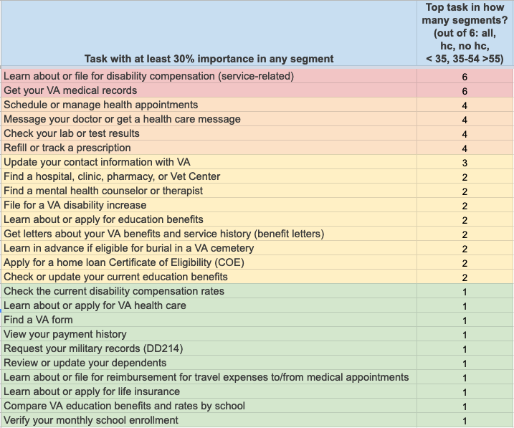
25 Top Tasks of 41 tested
6 Primary Top Tasks
9 Secondary Top Tasks
10 Tertiary Top Tasks

Slide 3
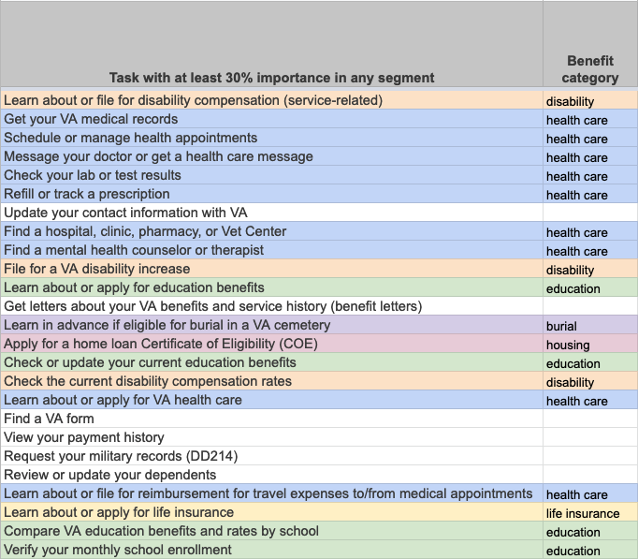
25 Top Tasks by Benefit Category
6 Primary Top Tasks
9 Secondary Top Tasks
10 Tertiary Top Tasks

Slide 4
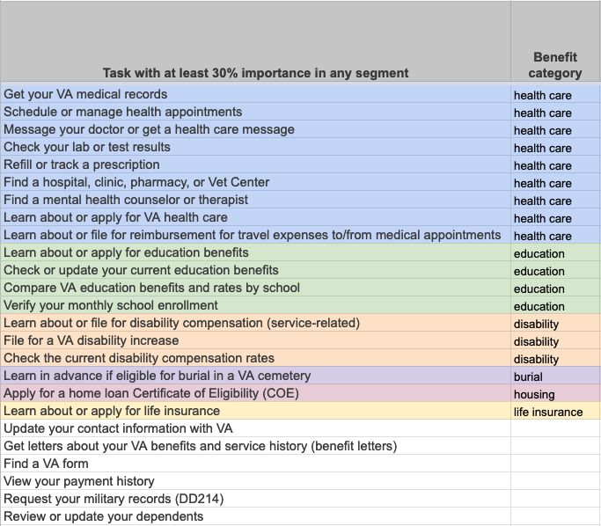
25 Top Tasks by Benefit Category, sorted
9 Health Care tasks
4 Education tasks
3 Disability tasks
3 Other
6 Independent of benefit categories

Slide 5
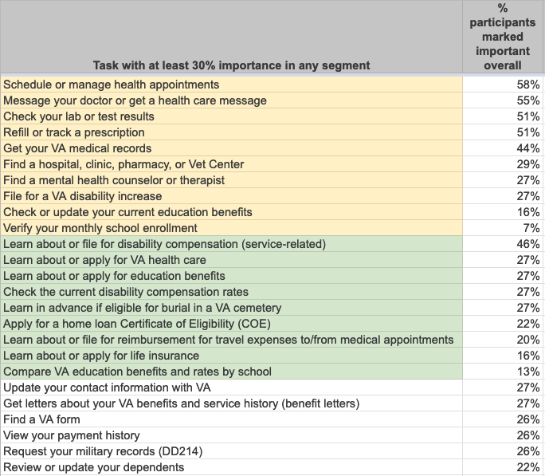
25 Top Tasks by Learn vs. Manage Benefit
10 Manage benefit tasks
9 Learn/Explore/Apply benefit tasks
6 Independent of benefits

